Slide 1

VMHS Engineering Pathway
Career Technical Education (CTE)
VISTA MURRIETA HIGH SCHOOL

Slide 2
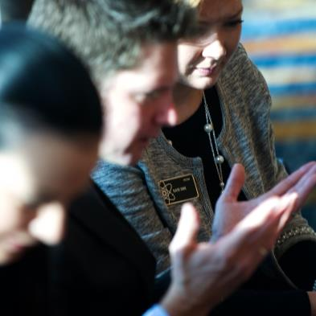
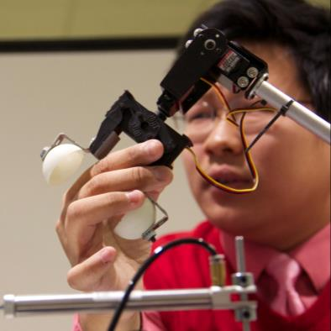
Activities (Instant Challenges)
Projects (Hands-on experience)
Problem-based Learning

Slide 3
Engineering Course Sequence (4 years)
Year 1
Year 2
Year 3
Year 4
V.P.A. credit
Engineering Design & Development (EDD)
Course #2447
Principles of Engineering (POE)
Course #2446
Digital Electronics (DE)
Course #2448
Intro to Design
(Engineering)
Course #2445
Notes:
Usefulness of Slide: Students can move laterally through specialization courses or “double up” on specialization courses
Customization / flexibility
A variety of scheduling scenarios (block, traditional, tri, blended, etc.)
Full year courses or semester long courses depending on scheduling
Students can “double up” on specialization courses
No specific sequence of courses
Typically: IED aligned with grade 9/10 math and science; POE and Specialization courses are 10/11 grade.
Some schools have implemented IED at 8th grade
Sample stories in a variety of communities (specific to DSE location)

Slide 4
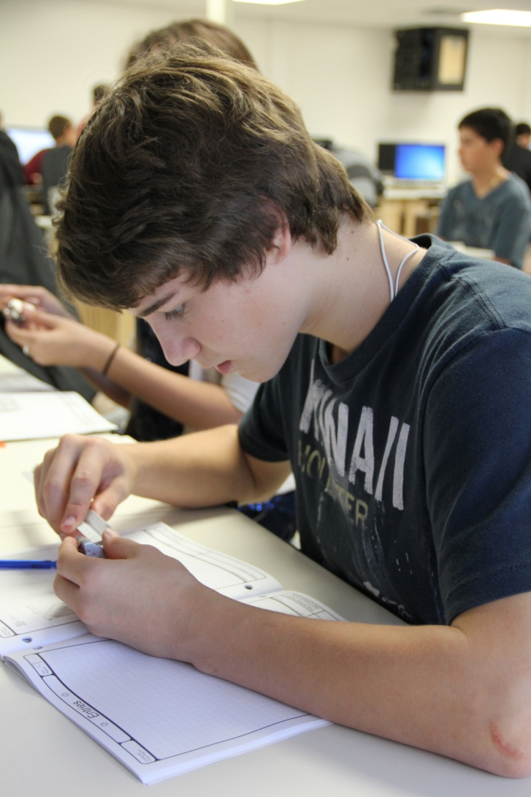
Introduction to Design (Engineering) Year 1
  Design Process
  Technical Sketching and Drawing
  Measurement and Statistics
  Modeling Skills
  Geometry of Design
  Computer-Aided Design (CAD)
  Reverse Engineering
  Project Documentation
  Advanced Computer Modeling
  Design Team
  Design Challenges

Slide 5
  Register for a Visual Art Course:
  Introduction to Design (Engineering) Course #2445
Priority List:
Grades: 9-10
Waiting List:
Grades: 11-12 ( submit name to your counselor)

Slide 6

RATE AN ENGINEERING MEDALLION
  “BE A PROJECT LEAD THE WAY (PLTW) SCHOLAR WHEN YOU DO A 3 OR 4 YEAR SEQUENCE OF THE ENGINEERING PATHWAY”

Slide 7
Register for a Visual Art Course:
Introduction to Design (Engineering)Year 1
Course #2445
Open to grades: 9, 10, 11
VMHS Applications available @ the Counseling Office,West /East Hall Offices
Contact: Mathematics and Engineering Teachers
          Mrs. Guia Mendoza- Blaske
          Email Address:gblaske@murrieta.k12.ca.us
          Mr. Cameron Larkins
          Email Address: clarkins@murrieta.k12.ca.us
          Phone Number:
          (951) 894-5750 ext. 6628
          Classroom #C13/C14 (C Building)

